Slide 1
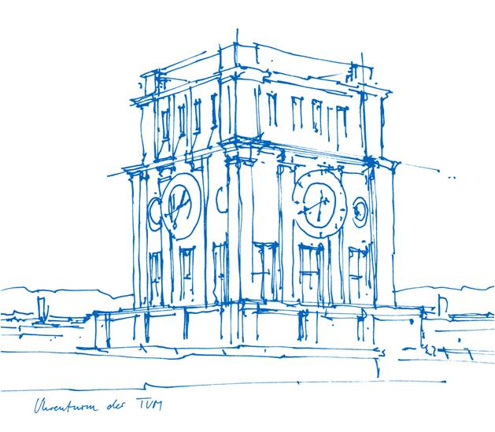
Human-Centered Computing: applications in natural language processing, network science, machine learning, and AI (IN0012, IN2106, IN4906_8)
CLARITY
Unmasking Political Question Evasions

Slide 2

18. November 2025
Dataset - Generating Summary

Slide 3

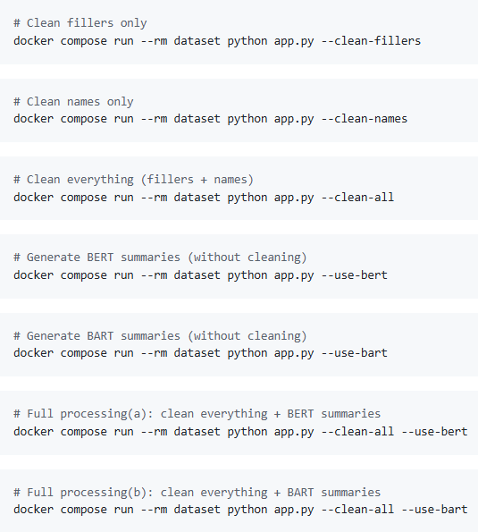
Dataset Tweaking - Steps
This approach allows creating different combinations of dataset tweaks based on passed flags to our app.
Cleaning: Fillers, Names
Summary: BERT, BART
3

Slide 4
Model Selection
facebook/bart-large-cnn
Pipeline
Read context_clean
Use BERT + MMR to select key sentences
Feed the text to BART for summarization
Store as summary_bart
4

Slide 5
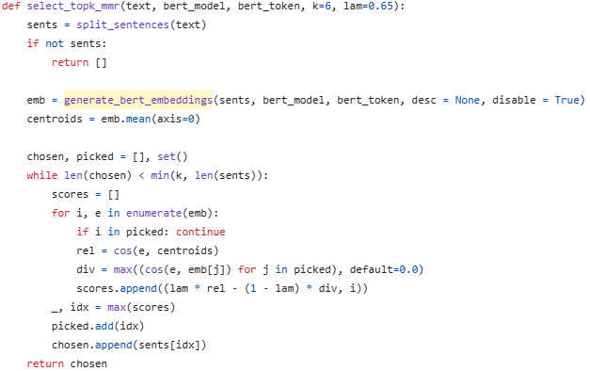
Key Sentences & MMR
Split long context on puncutation with cos similarity helper
Use BERT to pick sentences which are both representive and non-redundant
5

Slide 6
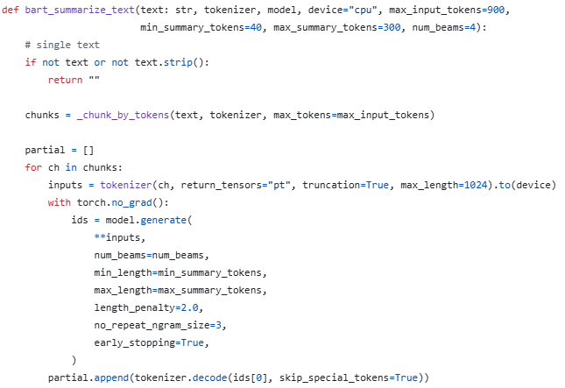
Summarization
Token-based chunks
Long text -> partial summaries -> fianl summaries
*summarize each chunks and combine
6

Slide 7
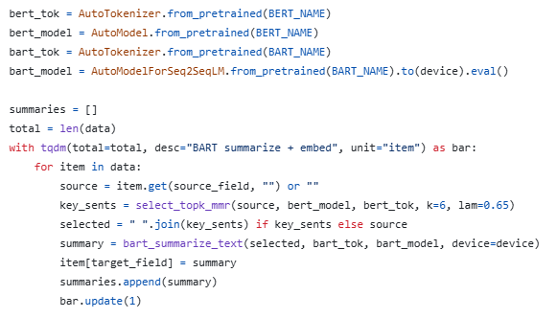
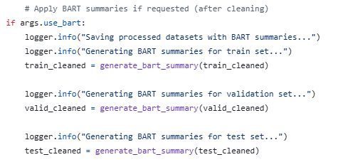
Public Entry Point & Sample
Receive data, handling the context in context_clean column
Generate summaries, storing as summary_bart
7

Slide 8
Next Steps
Optimization
Length of the summaries (40% - 60% of origin?)
Improvement to Speed
Need to be dicussed...
re-rank BART candidates using BERT cos scores
...
8

Slide 9
18. November 2025 Pipeline & Initial Experiments

Slide 10
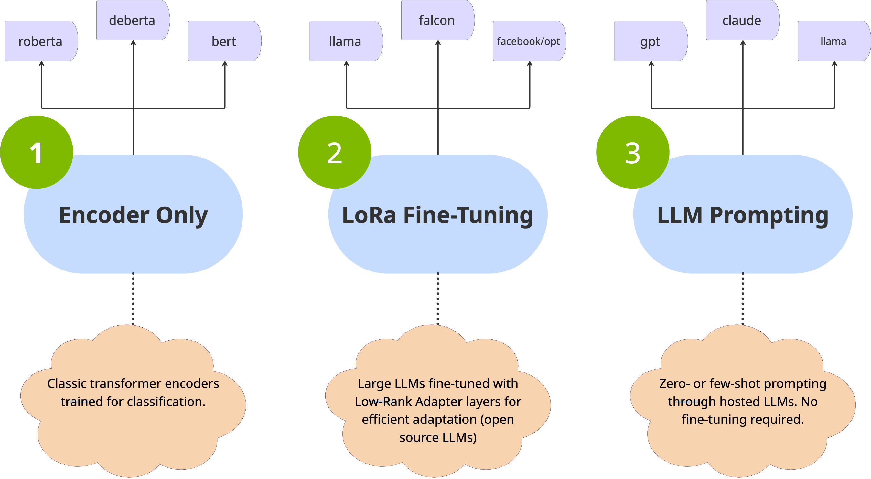
Classification Model Types

Slide 11
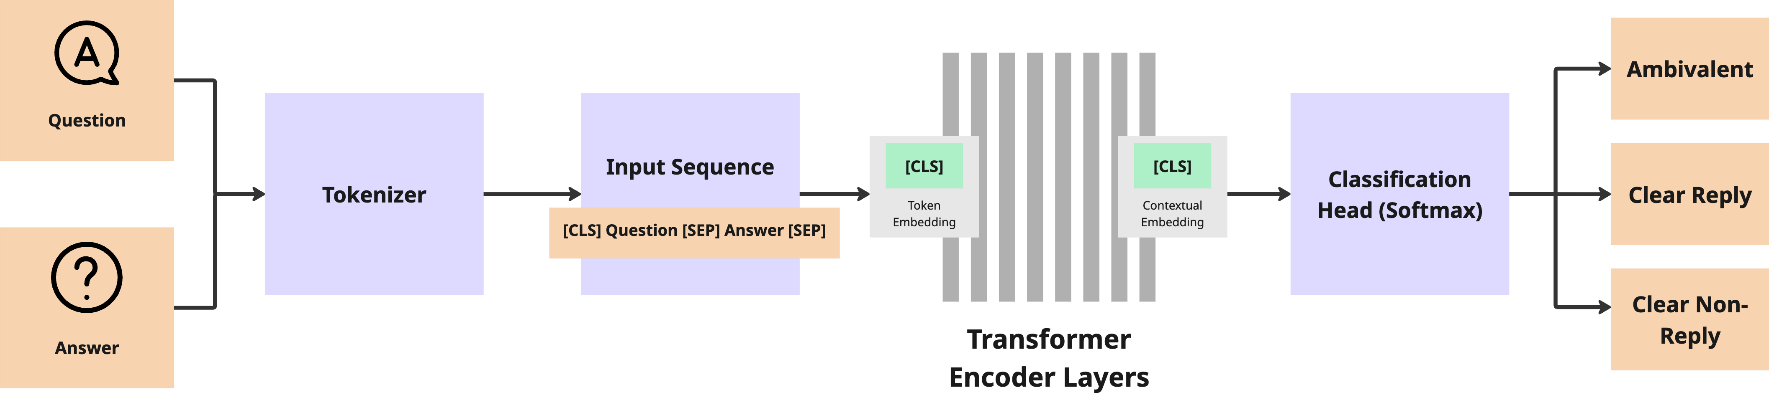
Encoder Models
Core Idea
convert both the question and answer into contextual embeddings and then predict one of the clarity classes based on their joint representation
Typical Models: roberta, deberta, distilroberta
Workflow
Both question and answer are concatenated into one input sequence
The encoder reads all tokens bidirectionally.
The final [CLS] vector represents the combined meaning of question and answer.
A small classification head predicts the label

Slide 12
Encoder Models
Training
Fine-tuning adjusts pre-trained weights to the Clarity labels
Mainly the classification head gets updated
Weaknesses for Task
Encoder-only models learn text similarity, topic alignment, response patterns
The models have no deep understanding of intention, context, or relevance. They recognize correlations, not causality
Evasion detection is not the same as semantic matching

Slide 13
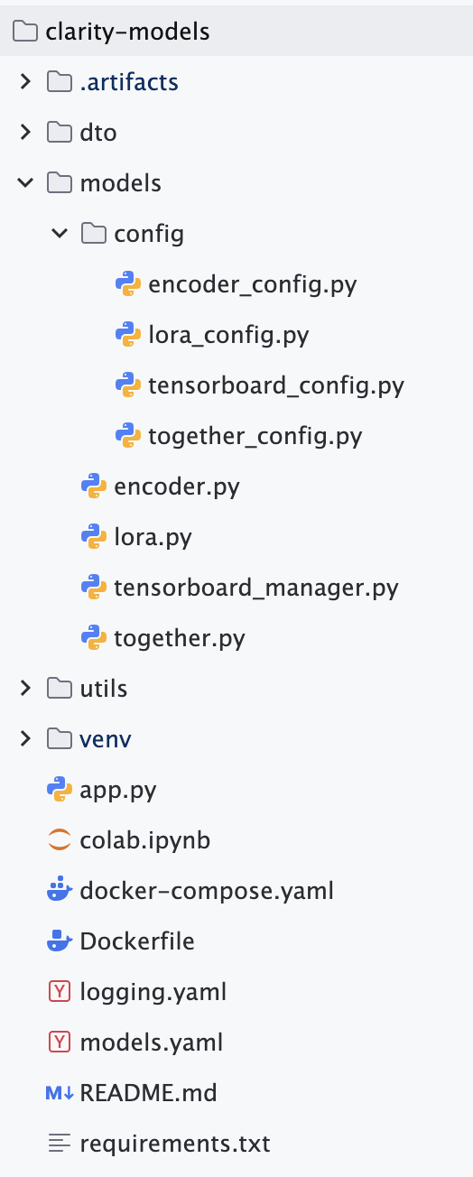
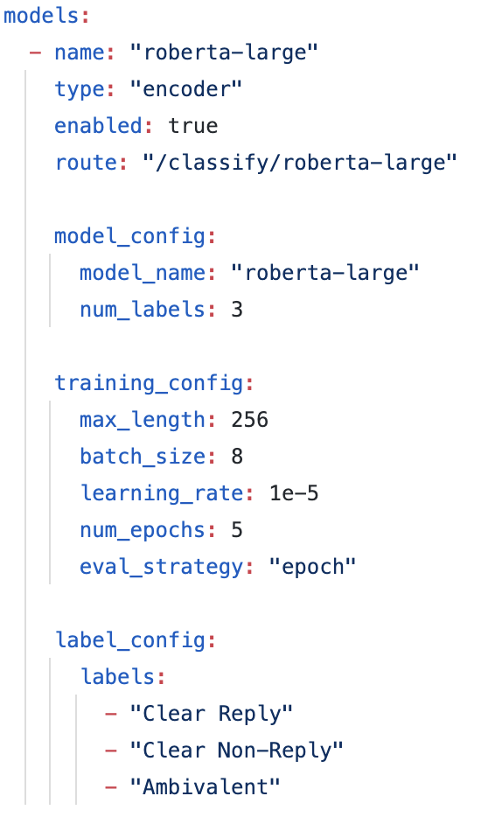
Encoder Models - Implementation
Python submodule in repository
clarity-models
Dependencies
transformers, torch, fastapi, uvicorn
datasets, accelerate, loguru, peft, PyYAML, bitsandbytes, sentencepiece, tensorboard, openai, requests, scikit-learn
Provides a configurable framework for training and serving classification models
Make implementation as dynamic as possible in order to train models with different settings
Define model configurations in a config file and the the rest is dynamically handled by the framework.

Slide 14
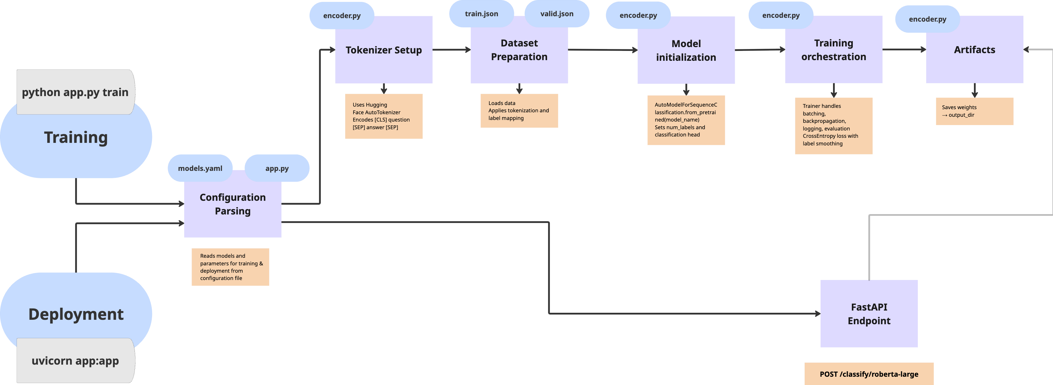
Encoder Models - Implementation

Slide 15
LoRA Fine-Tuned Models
Core Idea
LoRA (Low-Rank Adaptation) fine-tuning lets you teach a large LLM new classification behavior without updating all its billions of parameters.
Workflow
Start from a large pre-trained LLM (decoder-based, like GPT or Llama) and freeze the original weights.
Inject small trainable adapter matrices to attention and feed-forward layers.
During fine-tuning, only those adapters are updated.
The LLM learns the patterns within QA pairs through its natural language reasoning.
Training objective
Input: natural-language prompt (context + question).
Output: textual label like “Label: Clear Reply”.
Trained to complete prompts with correct labels (sequence-to-sequence objective).

Slide 16
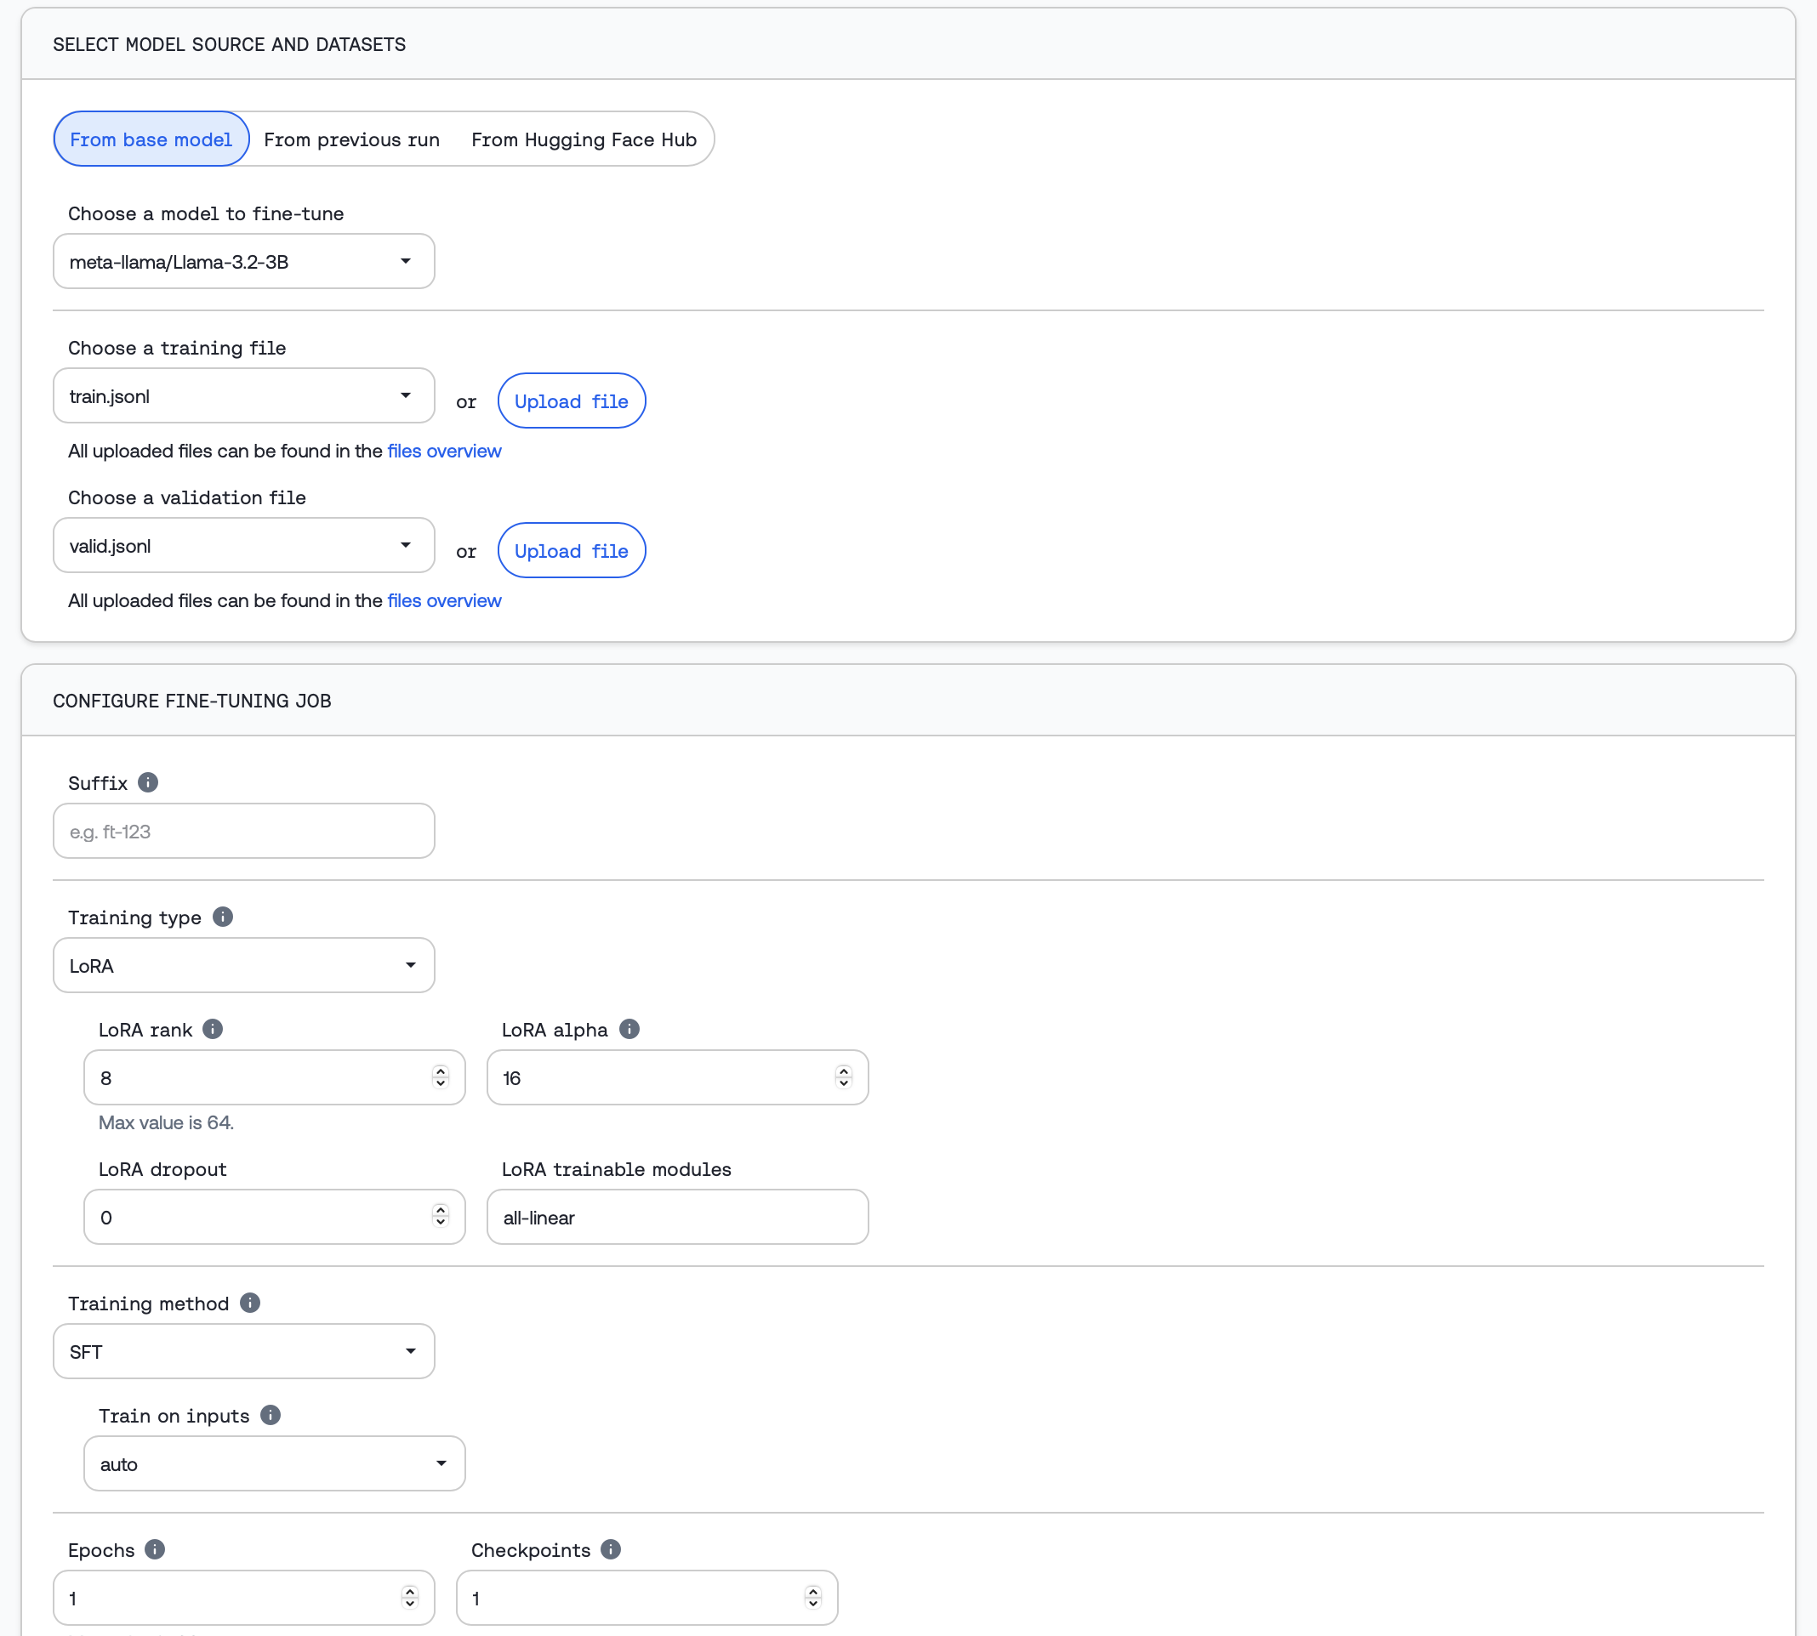
LoRA Fine-Tuned Models - Implementation
Initally training locally with clarity-models module
Similar workflow as the encoder models
Useless because larger models can not be trained locally or on Colab
Solution: Use a Model Provider that allows the fine-tuning of Open Source Models
Together AI (https://together.ai): Service for training, fine-tuning and inference on open-source models
Prepare dataset for training { "prompt": "<prompt-text-with-answer-and-question>", "completion": "Label: <clarity_label>" } { "prompt": "<prompt-text-with-answer-and-question>", "completion": "Label: <clarity_label>" }
Together AI provides a dedicated endpoint to access the fine-tuned model

Slide 17
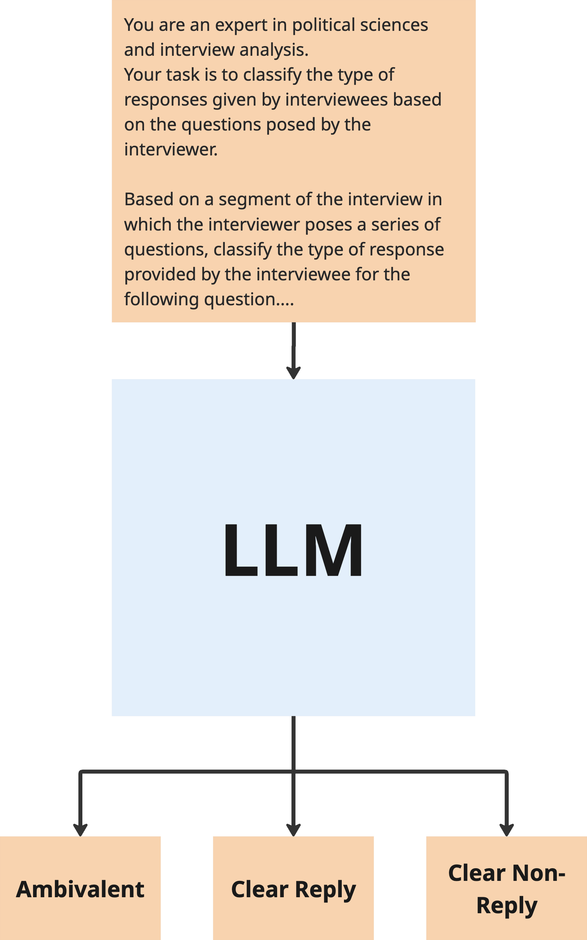
LLM Prompting
Core Idea
Use LLMs as reasoning engines via prompts. No training necessary.
Typical Models: gpt-5, gpt-oss-120b, claude-4.5-sonnet, LLaMA 70B
Prompting modes
Zero-shot: directly instruct the model (no examples)
Few-shot: include a few labeled QA examples before the test item
Use Prompt Engineering techniques to enhance result
Use via APIs provided by Model Providers (OpenAI, Anthropic, …)

Slide 18
Pipeline - Requirements
The system shall perform full inference runs from dataset loading to evaluation output in a single process.
The system shall store datasets, taxonomies, model configurations, predictions, and evaluations in database for future retrieval and analysis.
The system shall support multiple model types and providers (e.g., OpenAI, Anthropic, Together, locally hosted).
The system shall allow all aspects of the classification pipeline to be configured via external files, enabling reproducible experiments and dynamic adjustments.

Slide 19
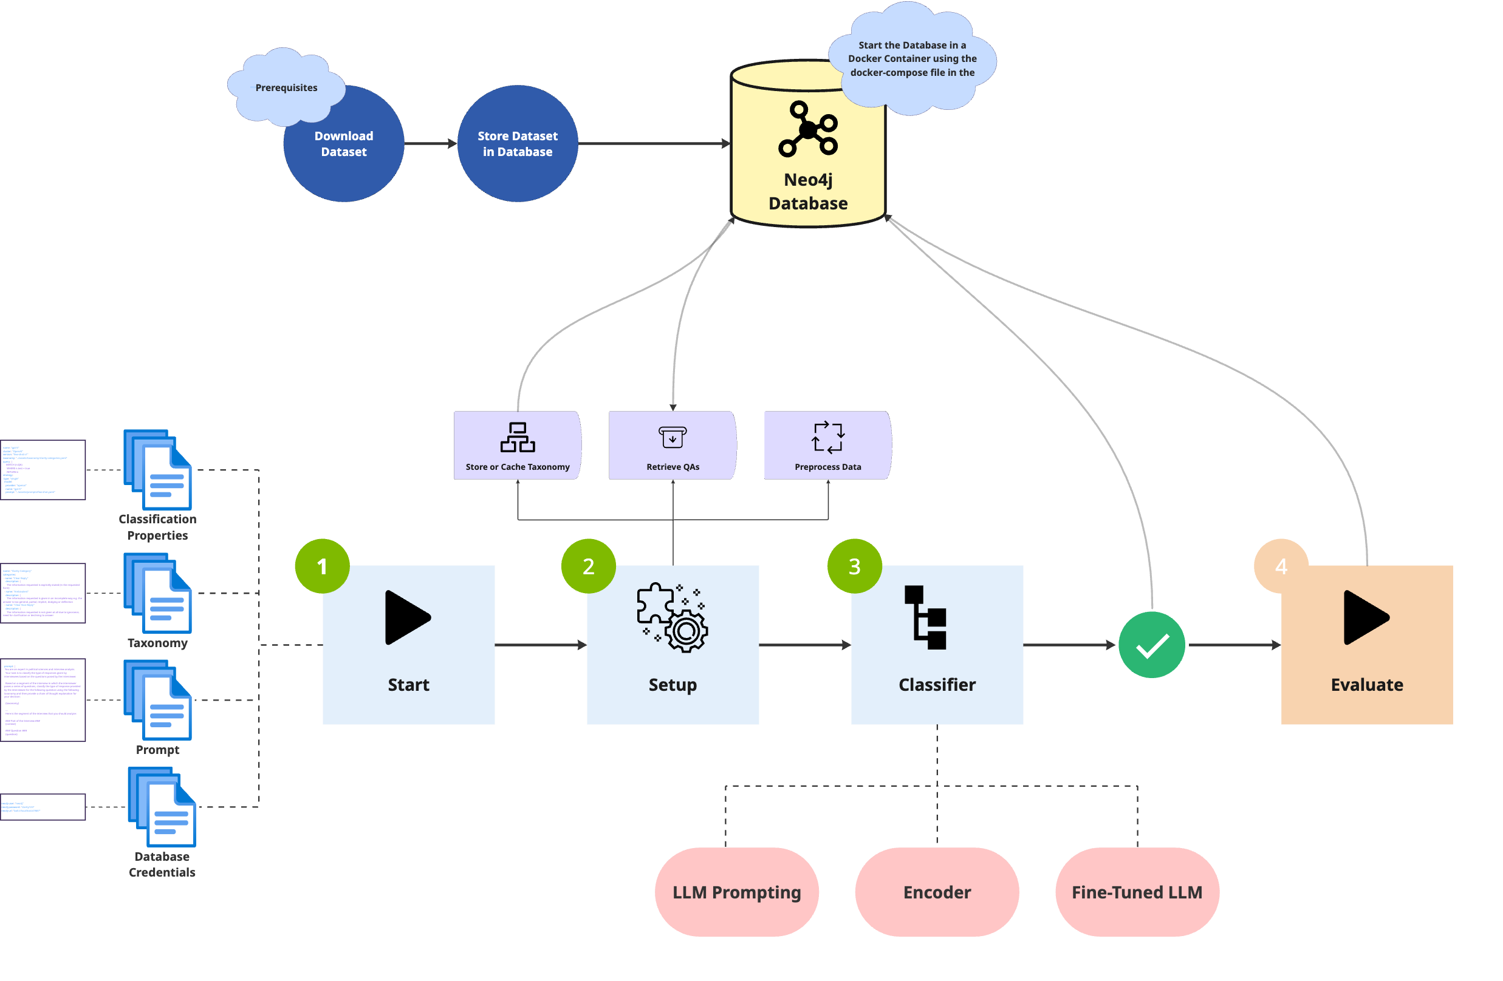
Pipeline - Architecture

Slide 20
Pipeline - Technical Details
Implementation in Java
3 submodules in repository
clarity-utils: Contains general java utility classes and functions used across the project
clarity-neo4j: Handles interactions with the Neo4j database and provides utilities for managing neo4j data.
clarity-pipeline: Actual services and logic used in the classification pipeline
Data ingestion/processing
Classification
Evaluation
Configurations are written in YAML files that are parsed by the pipeline
Taxonomy
Prompts
Database Credentials
Pipeline Properties

Slide 21
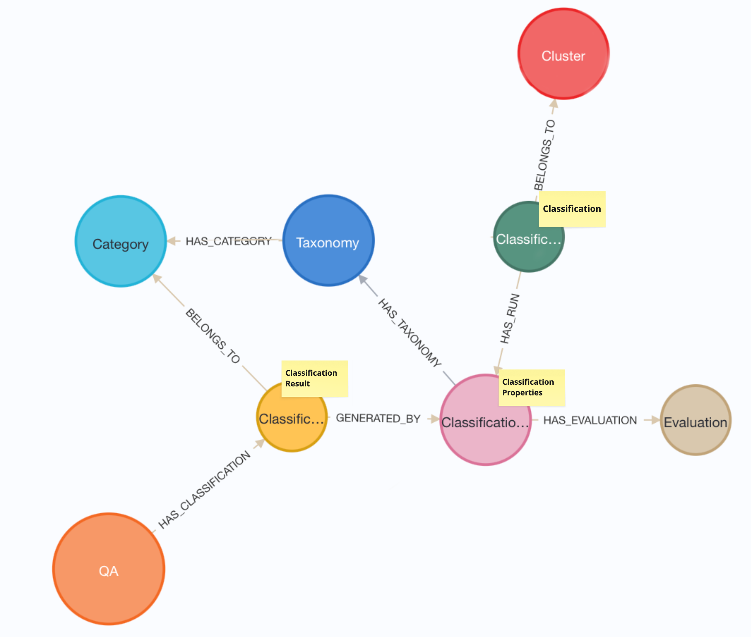
Pipeline - Graph Ontology

Slide 22
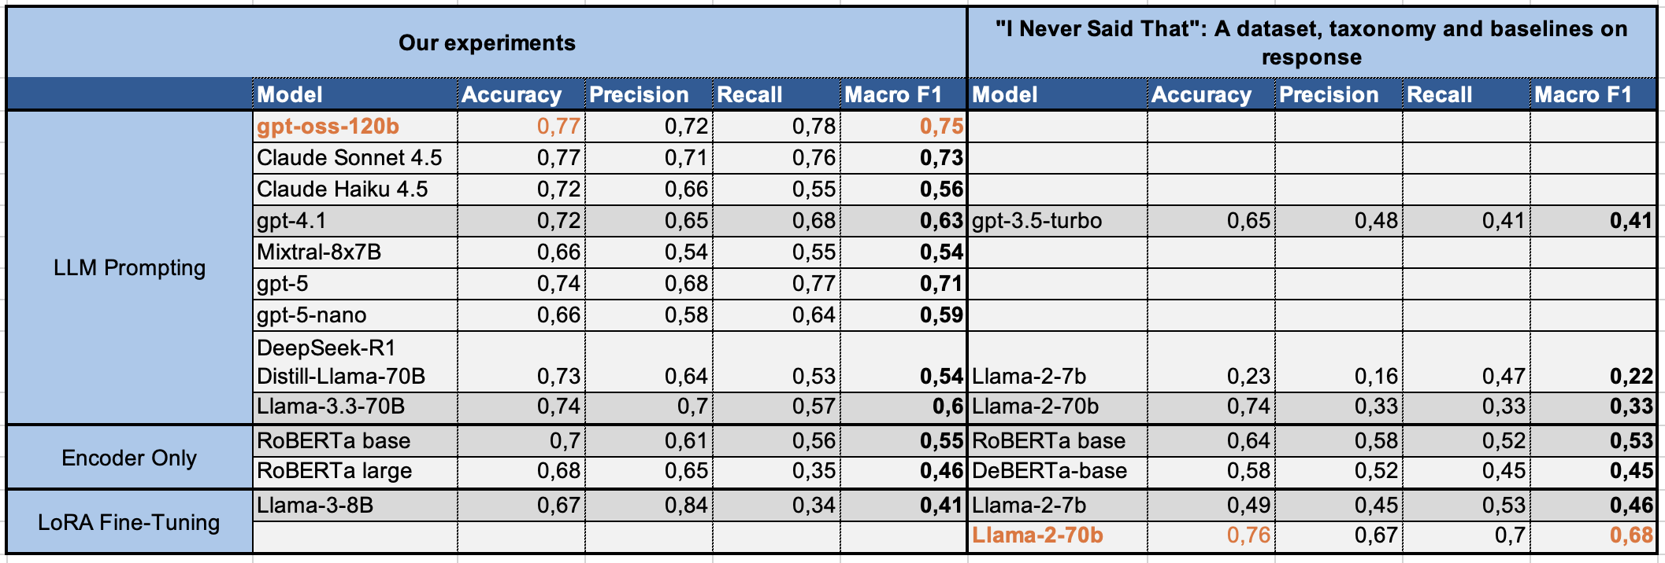
Initial Experiments

Slide 23
Outlook
Analyze results of classification
Use strengths & weaknesses of different models
Improve approaches in targeted manner
Enhance existing approaches
Prompt engineering
Use different training settings
Use preprocessed data
Cleaning
Summarize
Paraphrase

